Slide 1
How I am feeling
Canterbury STLS

Slide 2
Developing understanding of emotions
Very young children need support to understand the emotions and feelings they have. (see advice sheet Developing Understanding of Emotion Words https://www.st-nicholas.kent.sch.uk/STLS/advice-for-sencos )
Young children are unable to regulate their emotions without support. Co-regulating adults help them identify and name strong emotions or when they are just having an ‘okay’ day.
Children need to be taught that all emotions are natural and nothing to be scared of. It is how we manage those emotions that is important. Adults will need to teach coping strategies to help children understand what they can do to help them manage these feelings.
Best Practice Guidance for the Early Years – Social Emotional Mental Health (pg 50-59) will give you many ideas and strategies to embed good practice within your setting.

Slide 3
How to use this resource
Print off the resource and laminate the individual emotion slides
Use this with individual children or small groups when they are feeling safe and calm
Use with books about emotions such as ‘The Colour Monster’, ‘What makes me happy?’ and ‘Listening to my body’
Talk about how we all feel emotions differently. How does their body feel when they are happy?
Use mirrors to support children understand what ‘faces’ look like when experiencing different emotions
Help them name their emotions throughout the day

Slide 4
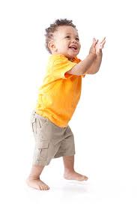
When I am happy my body feels…
laughing
lively
enjoy things
bouncy
smiley face
happy face
sleep well
friendly
want to play with things and people

Slide 5
When I feel scared my body feels
hot
dry mouth
wobbly tummy
jelly legs
upset
need the toilet
lips tremble
headache
heart beats faster

Slide 6
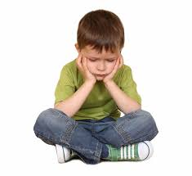
When I feel sad my body feels…
don’t want to play with anything
not hungry
sad face
body feels heavy
grumpy
can’t get to sleep
crying
easily upset
feel tired
feel sick

Slide 7
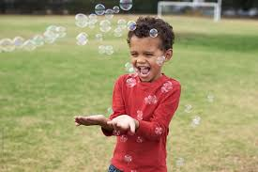
When I feel excited my body feels …
my tummy feels squishy and fluttery
buzzy
tingly
my heart starts pounding
smiley face
want to run
bouncy
want to talk

Slide 8
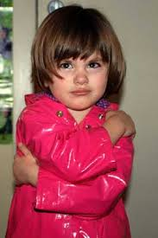
When I feel angry my body feels …
hot
headache
lips tremble
sweaty hands
upset cry
clench fist push
shouting name calling
shake
angry face
Say things I don’t mean
throw things

Slide 9
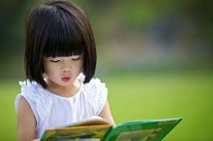
When I feel calm my body feels …
quiet
gentle
breathing slowly
warm
able to play
relaxed
comfortable
can think about things
chatty
aware of things around me

